Slide 1

CAMPUS PARTY
We are Team Husky Go
1805353 Ziqing Lu
1494510 Chen Wang
1409076 Hsiang-Hua Chen

Slide 2



OUTLINE
What is the problem?
How do we solve this?
How does this solution work?

Slide 3


WHAT’S THE PROBLEM
Many students are living on their own planets and isolate themselves from the enormous social network.
Lack of access to activities
Unhealthy Lifestyle
Weak Connections

Slide 4

CAMPUS PARTY
OUR SOLUTION:

Slide 5



IMPACTS
INFO
Provide a platform that gives students accesses to information of different activities
LIFESTYLE
Students will have more healthy options for their lifestyles
CONNECTION
Create and strengthen connections between students

Slide 6


Slide 7
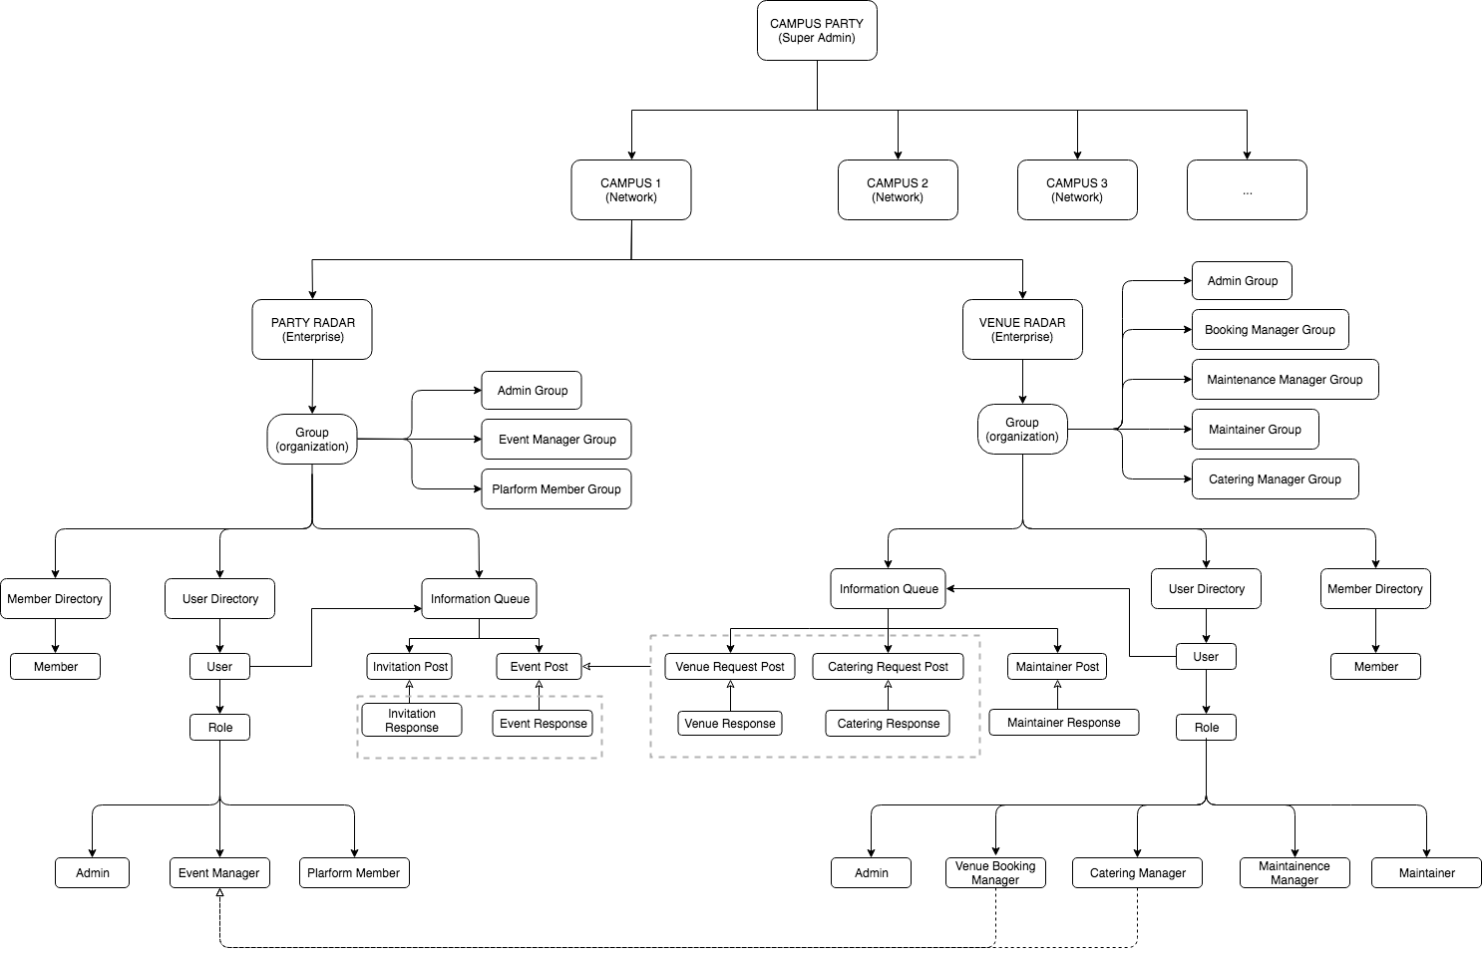
!: communication between enterprises
!: students from different campuses can respond

Slide 8






USE CASES
Venue
Manage Venue
Manage Catering
Party Organizer
Book Venue
Students
Attend Event
Build Connection
Manage Maintenance
Book Catering
Manager Event

Slide 9

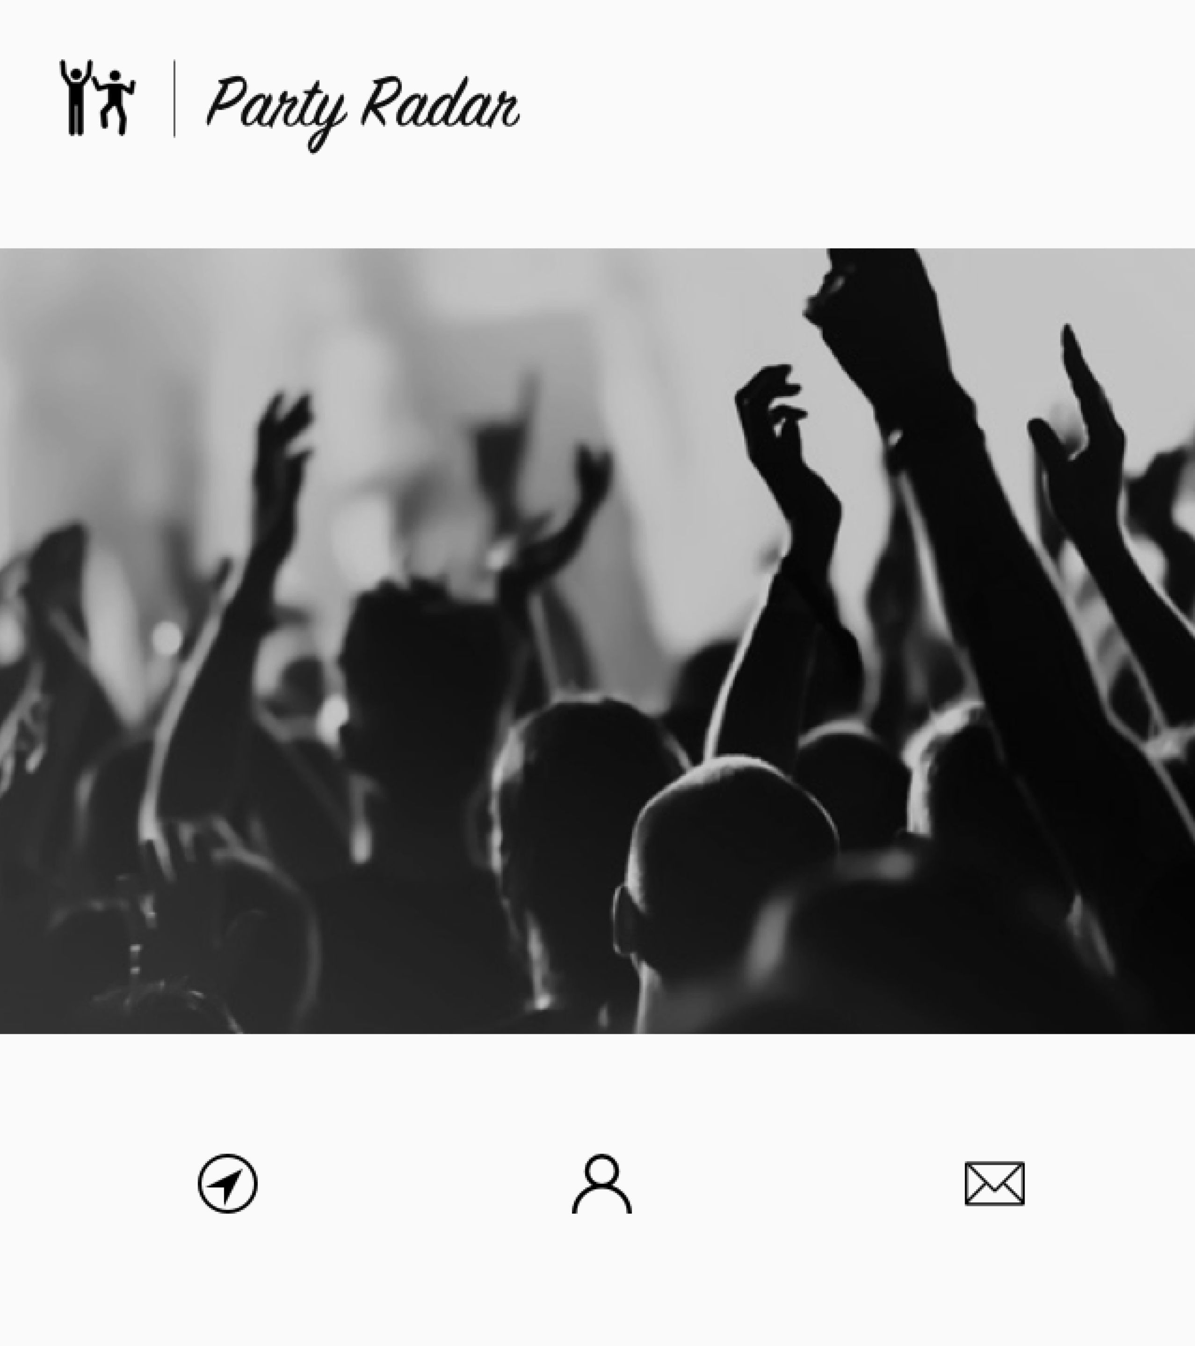
DETAILS
REVIEW

Slide 10

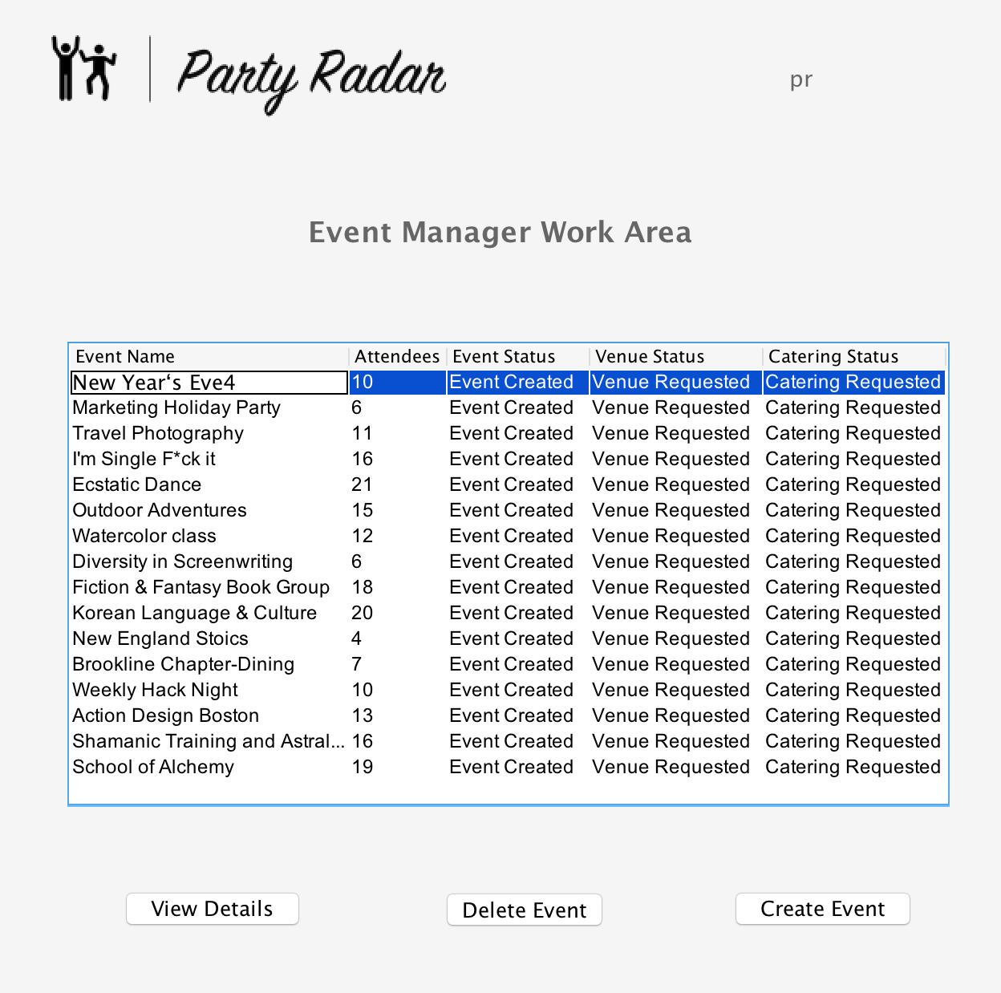
START PARTY

Slide 11
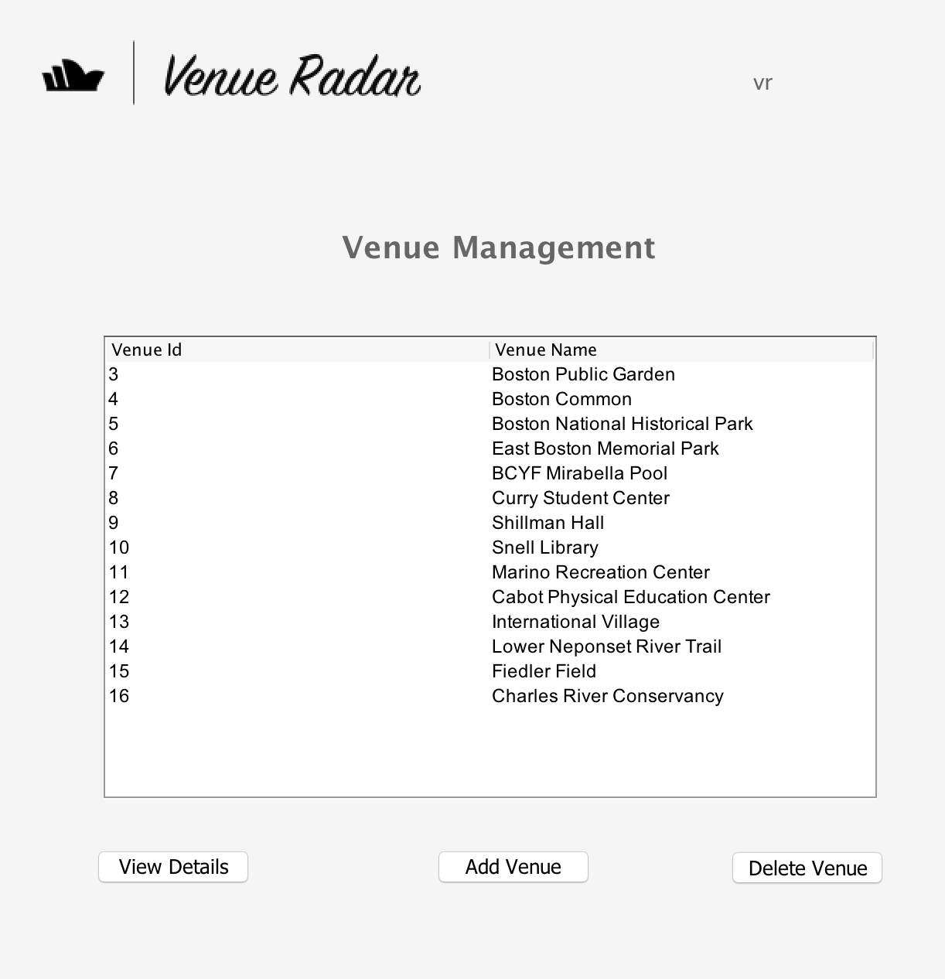
GREAT PLACE

Slide 12
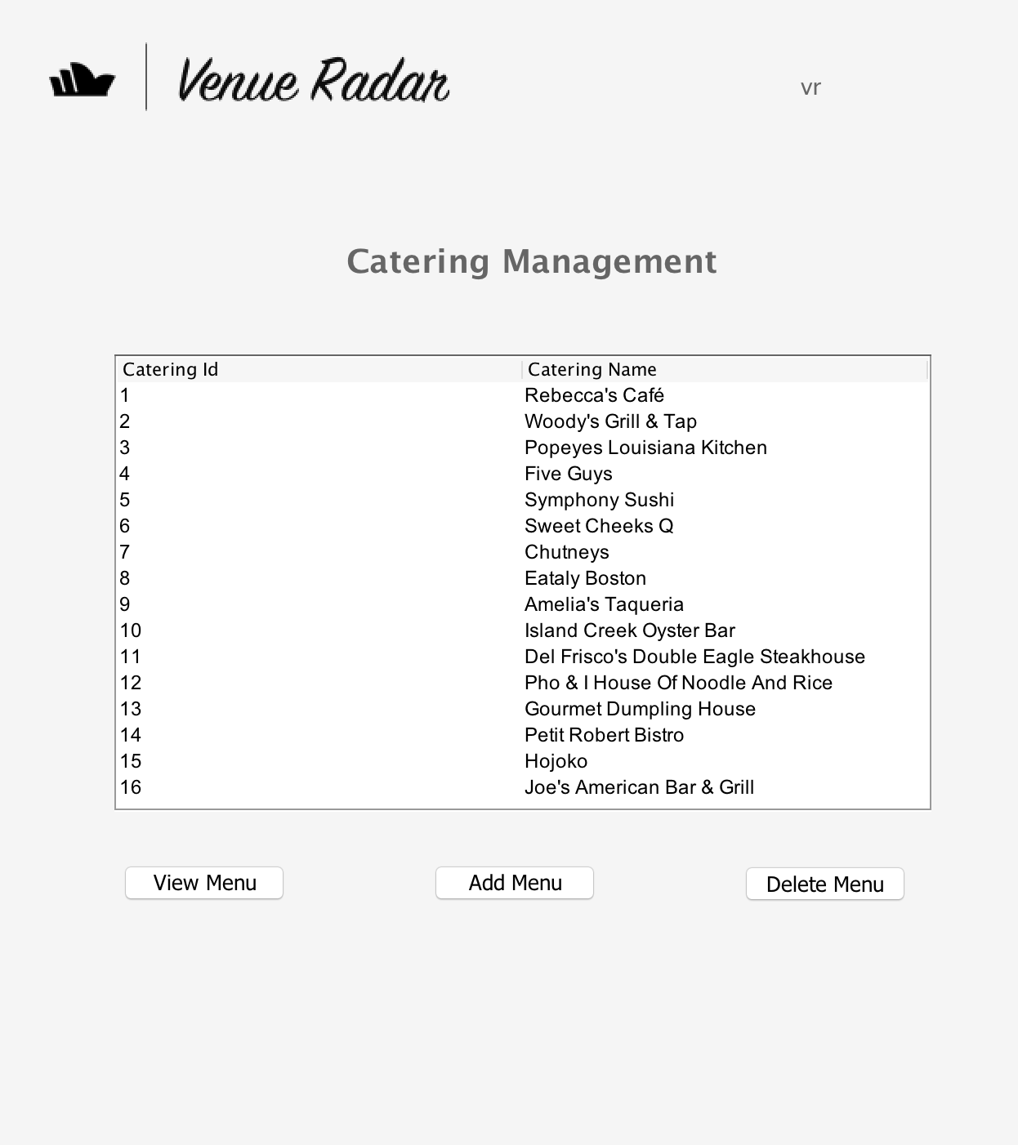
FANTASTIC FOOD

Slide 13
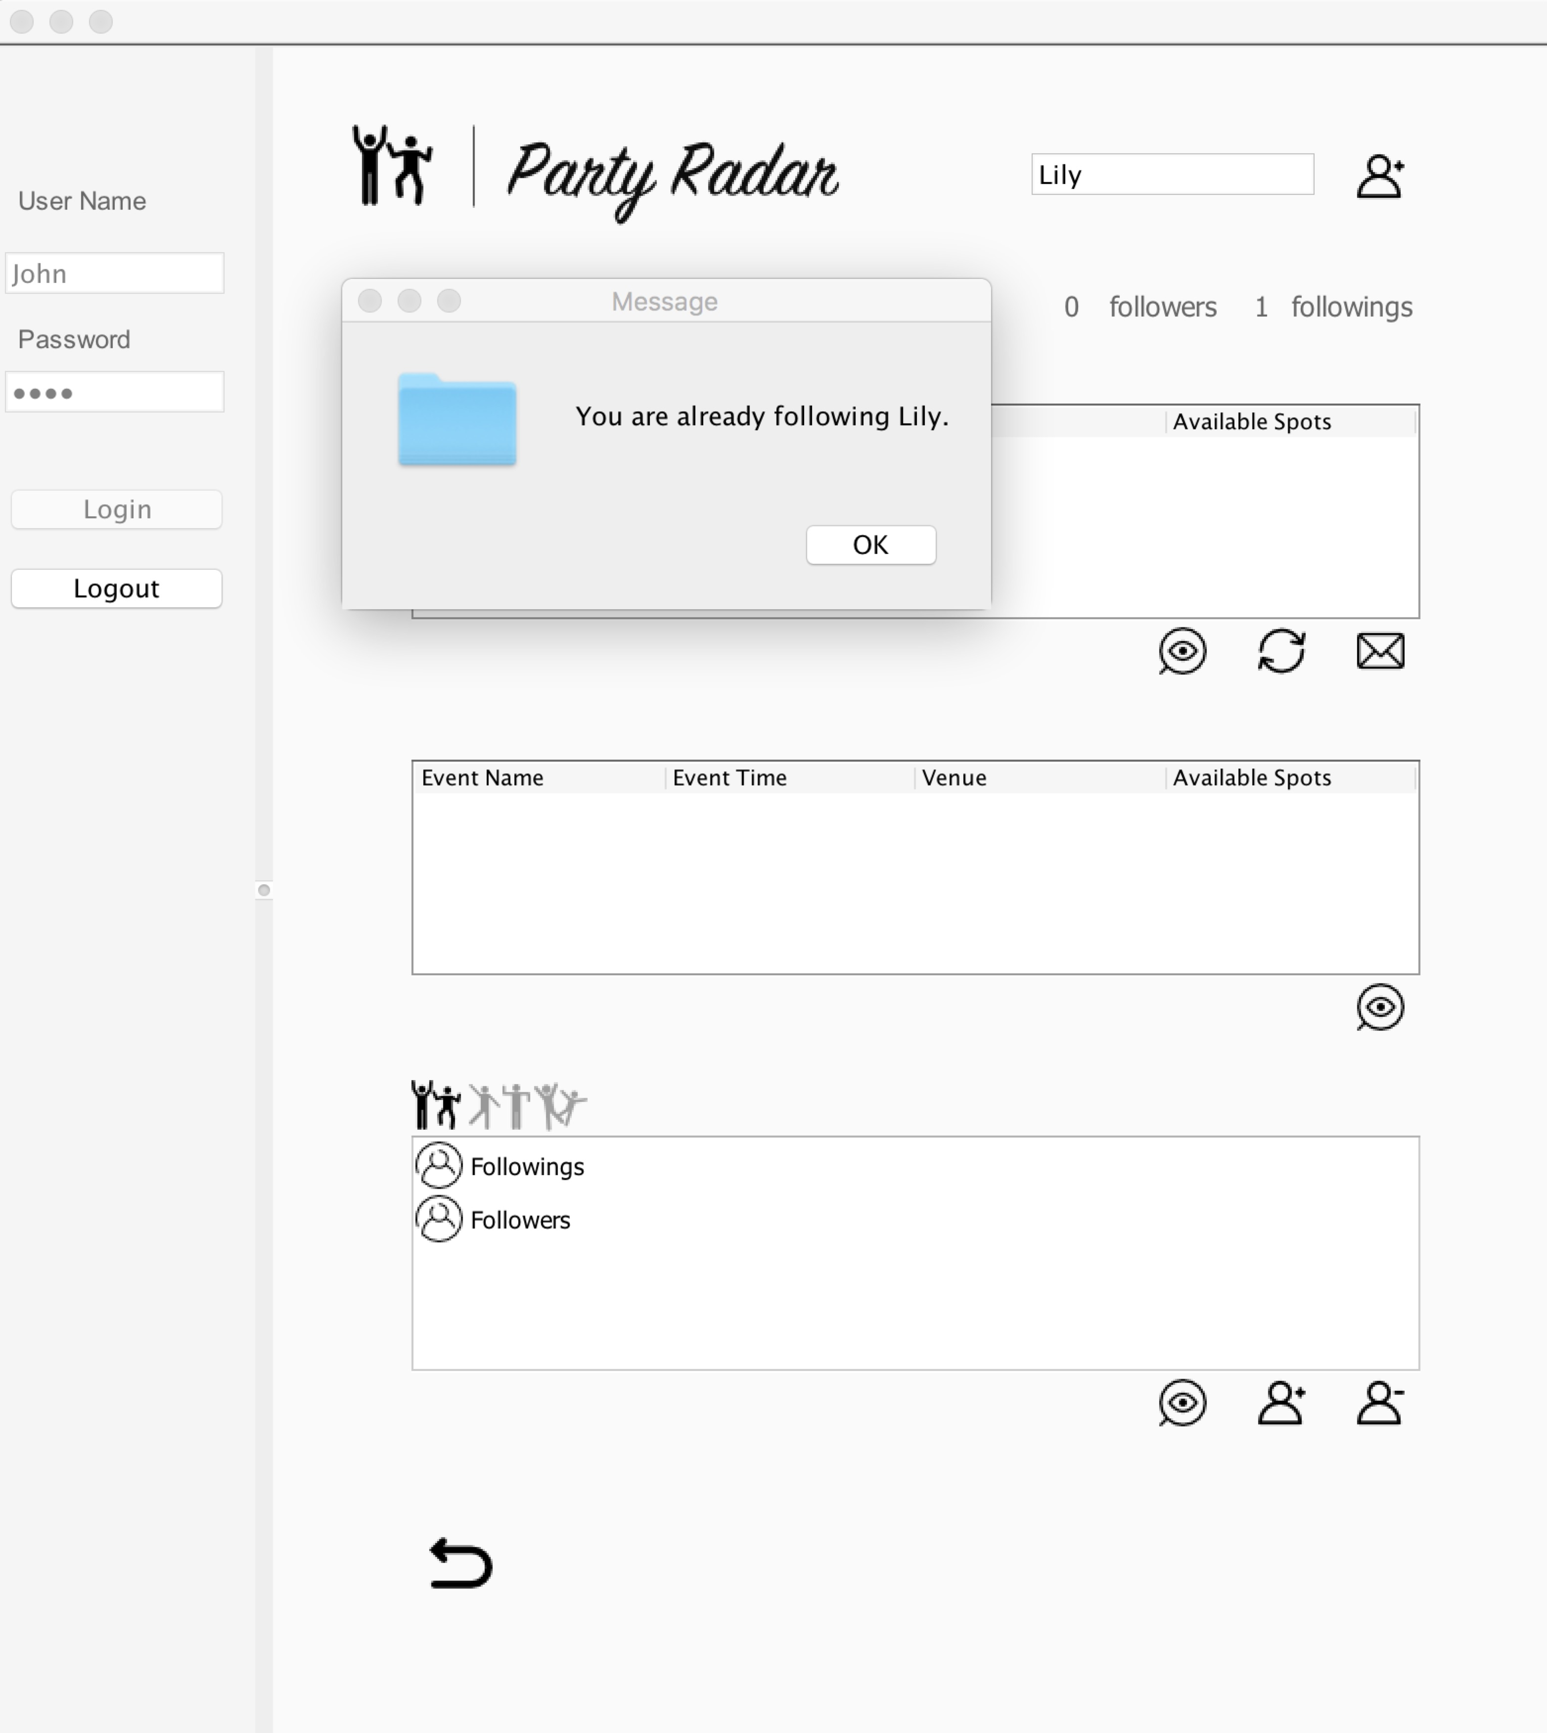
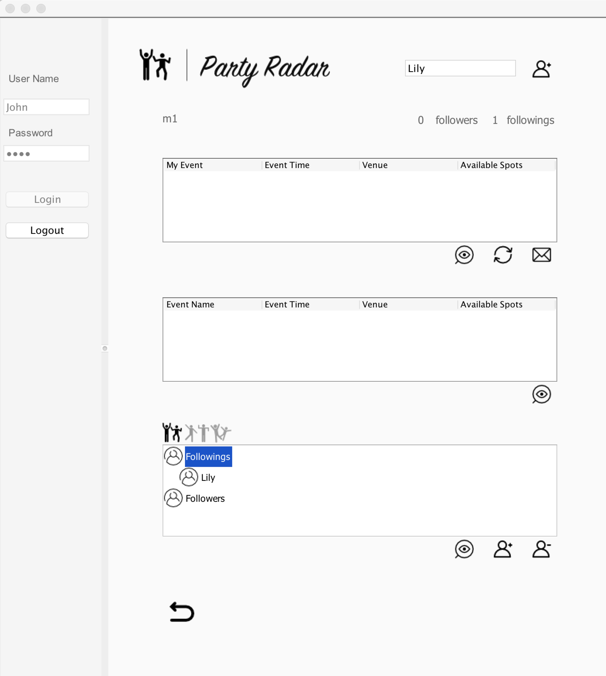
GET CONNECTED

Slide 14
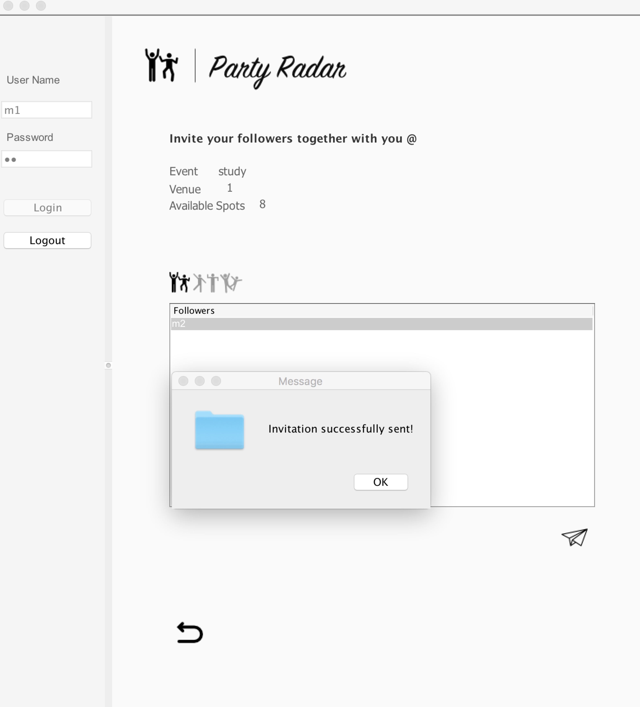
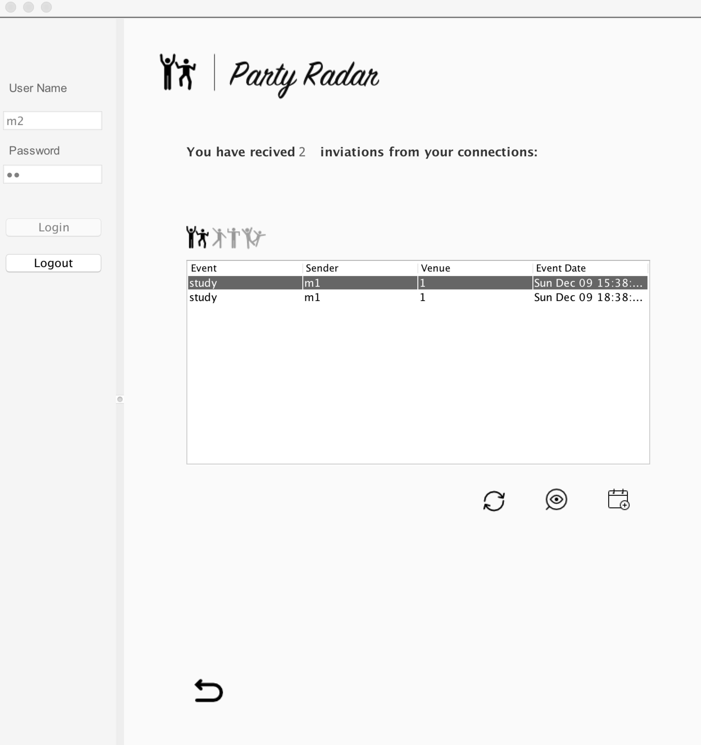
INVITE YOUR FRIENDS

Slide 15
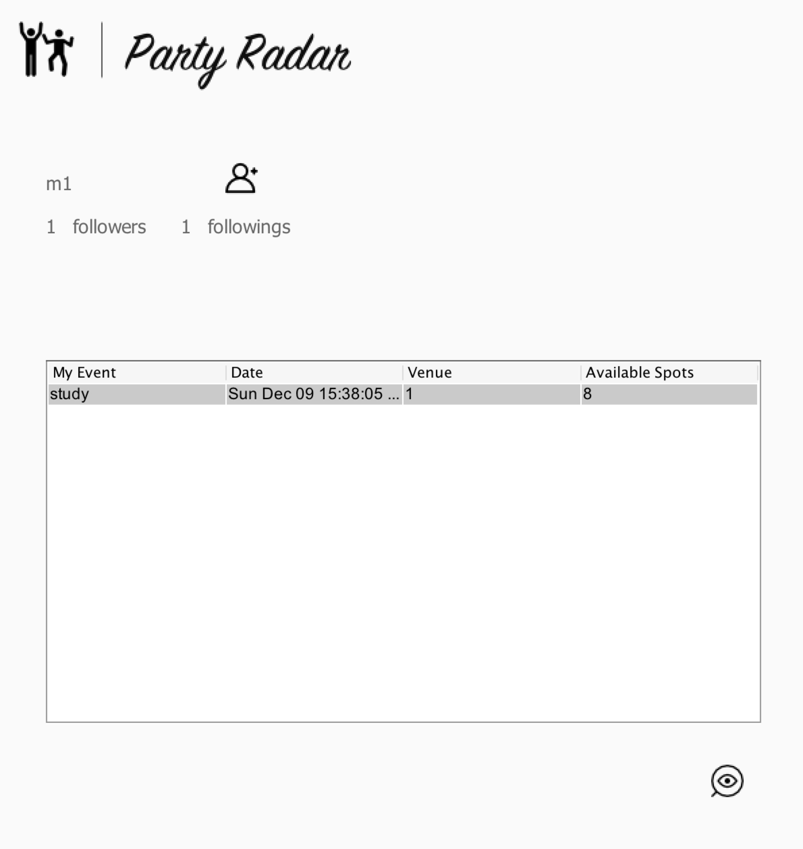
JOIN YOUR FRIENDS

Slide 16
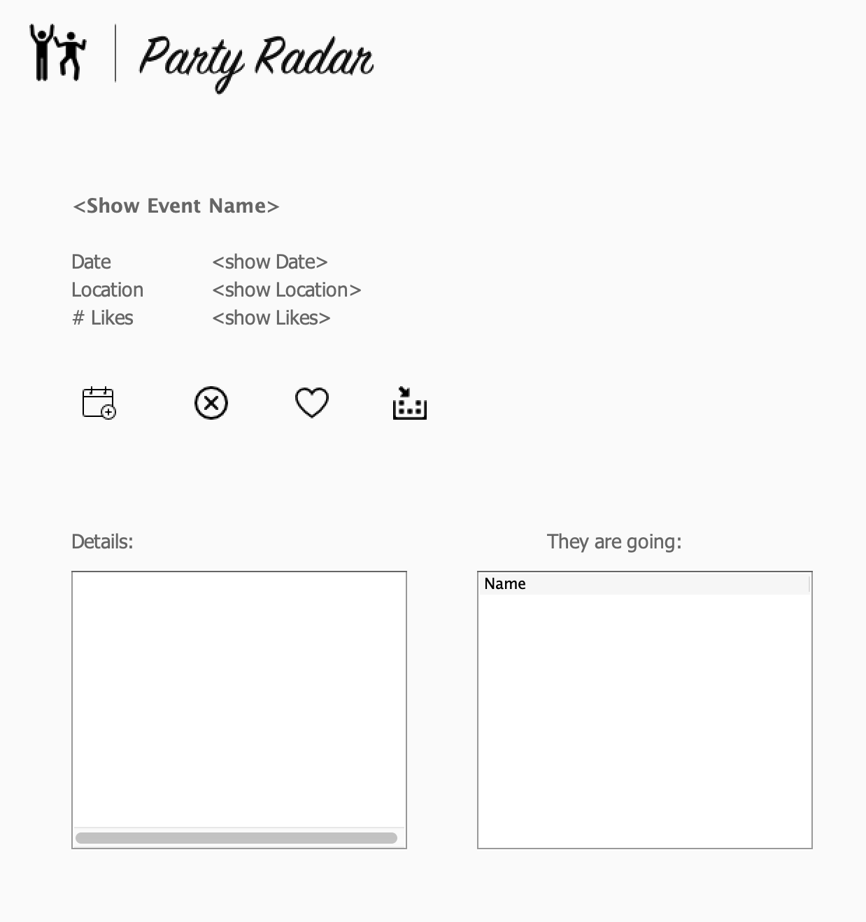
JOIN EVENT

Slide 17
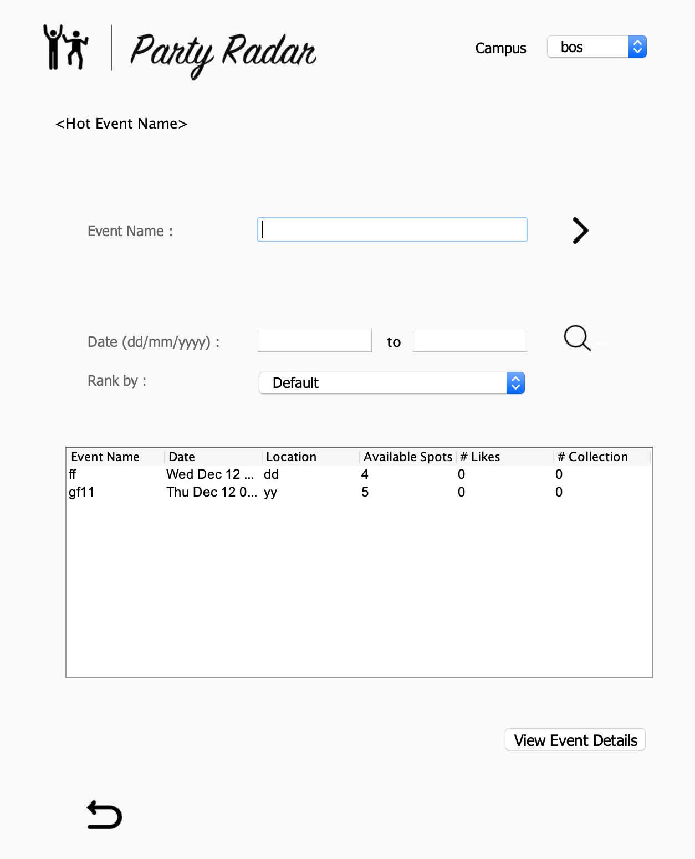
CHOOSE YOUR EVENT

Slide 18

Thank You
For Listening!

